Slide 1

BANK WITH FARGO
AN ONLINE BANKING SYSTEM

Slide 2

TEAM MEMBERS
Manan Agarwal
Isha Jain
Sankita Mandal

Slide 3

PROBLEM STATEMENT
Develop an online banking system that aims to provide a convenient and secure platform for users to manage their finances remotely with the following features:
User registration and login
Opening a bank account
Funds transfer
Deposit and withdrawal functionality
Checking account balance
Transaction history
The application should have an admin portal with the following features:
Search for a user
Enable/Disable any account
View transactions of any account

Slide 4

TECH STACK
BACK-END
FRONT-END
PLATFORMS
React Js
Bootstrap
Spring-Boot : Spring Boot makes it easy to create stand-alone, production-grade Spring based Applications
GitHub: A platform and cloud-based service for software development and version control
Postman: API platform for developers used to test endpoints
DATABASE
MariaDB :
MariaDB Server is one of the most popular open source relational database.

Slide 5

FEATURES
User-Friendly Interface: The project boasts an intuitive and user-friendly interface, making it easy for customers to navigate and access banking services.
Secure Authentication: Robust security measures, including multi-factor authentication, safeguard customer data and prevent unauthorized access.
Account Management: Customers can efficiently manage their accounts, view balances, track transactions, and even do payments, all from the comfort of their homes.
Effortless Fund Transfer: Customers can seamlessly transfer funds between their own accounts or to external accounts, streamlining financial transactions.
Admin Tools: For bank administrators, the system provides a powerful dashboard to manage user accounts, monitor transactions, and maintain the system's overall integrity.
Data Security: Stringent data encryption and regular security audits protect customer data against cyber threats, ensuring peace of mind for all users.

Slide 6
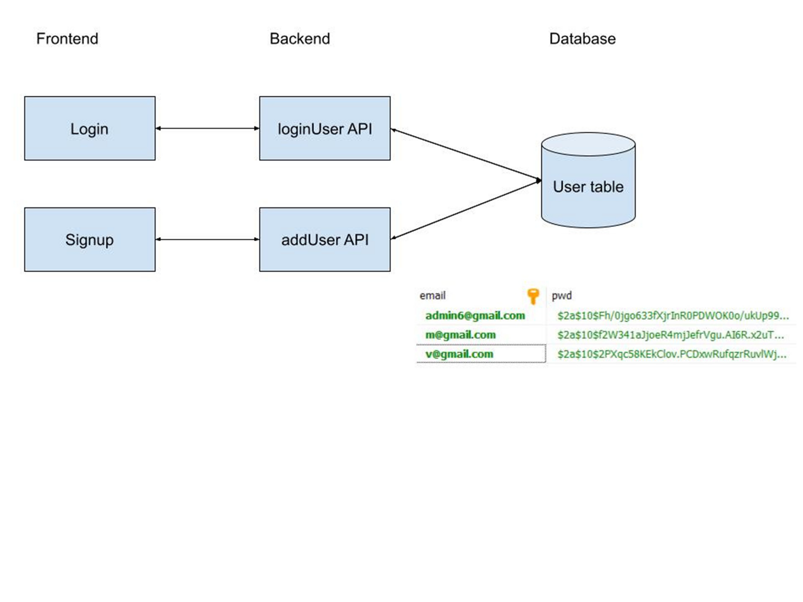
Flow Diagram

Slide 7
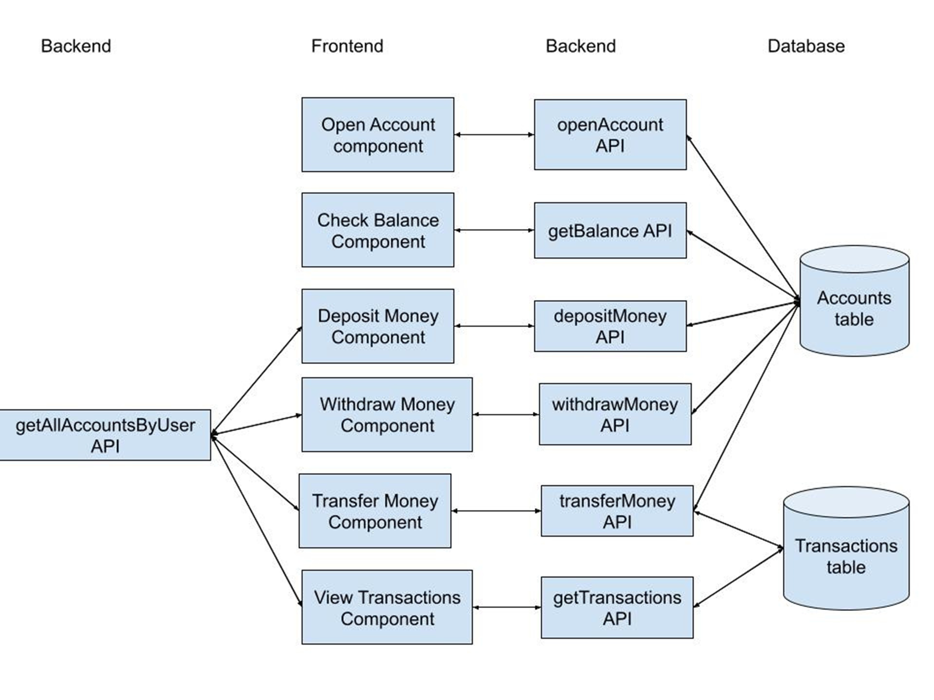
User View

Slide 8
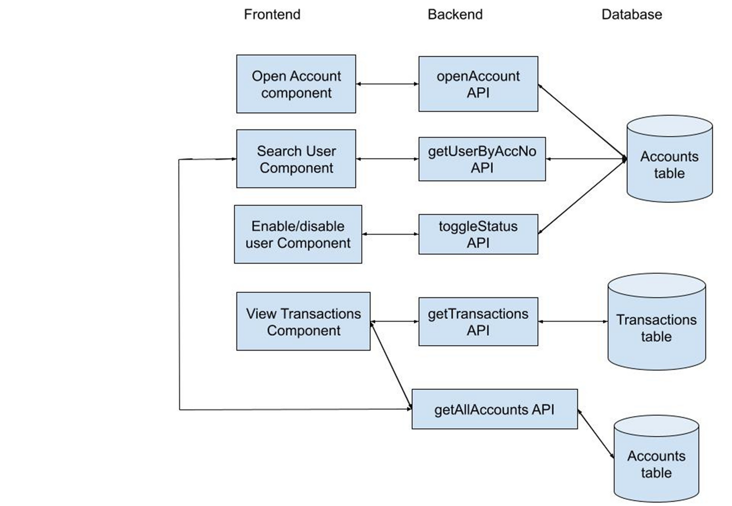
Admin View

Slide 9

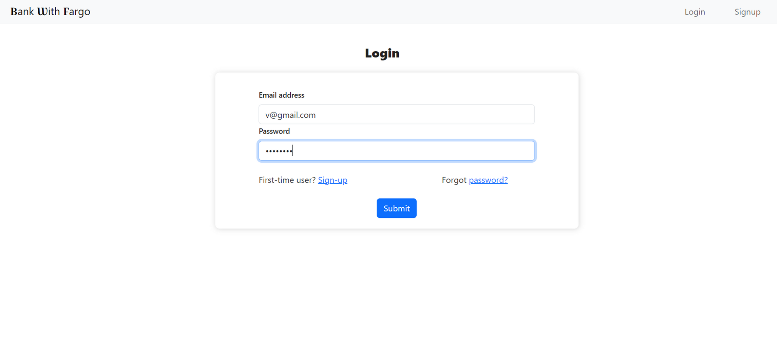
LOGIN PAGE

Slide 10
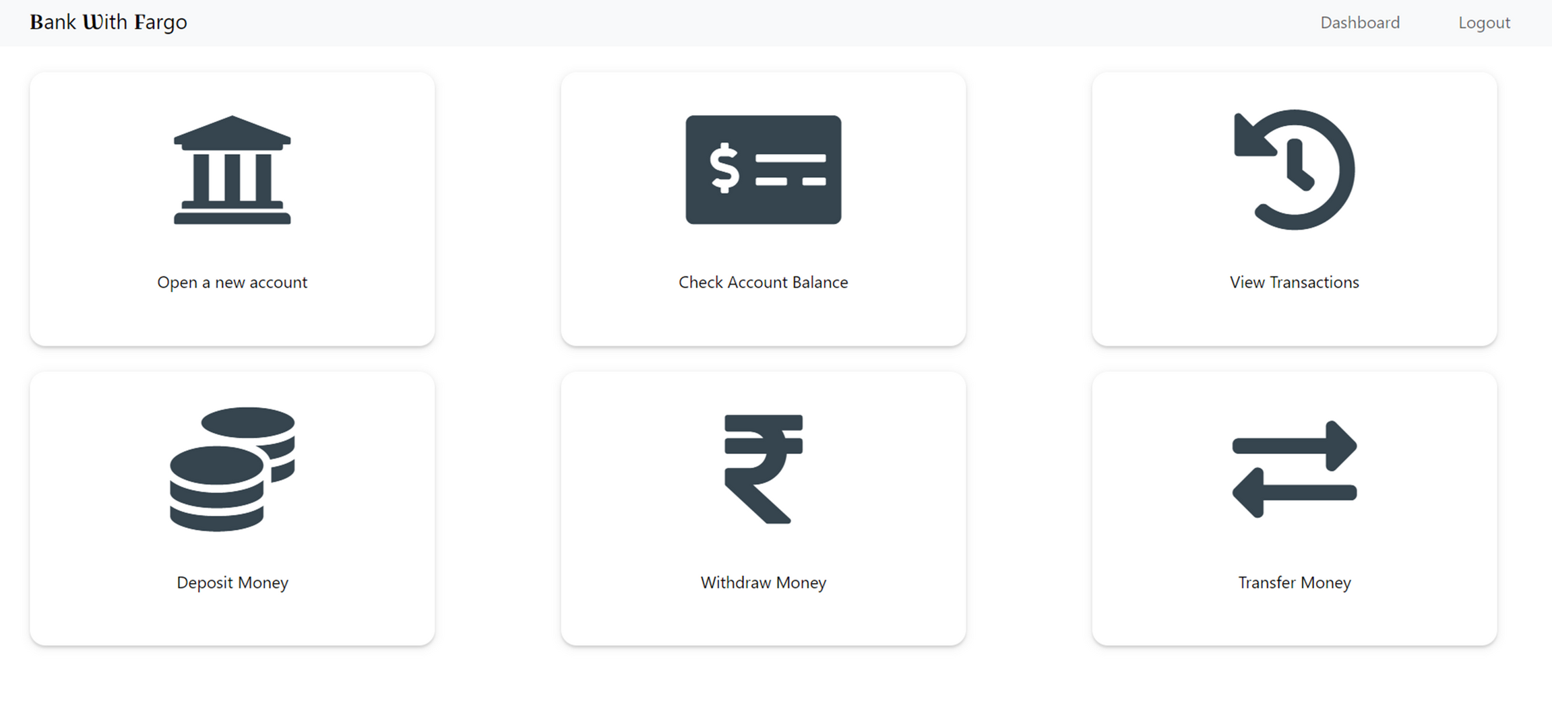
DASHBOARD

Slide 11
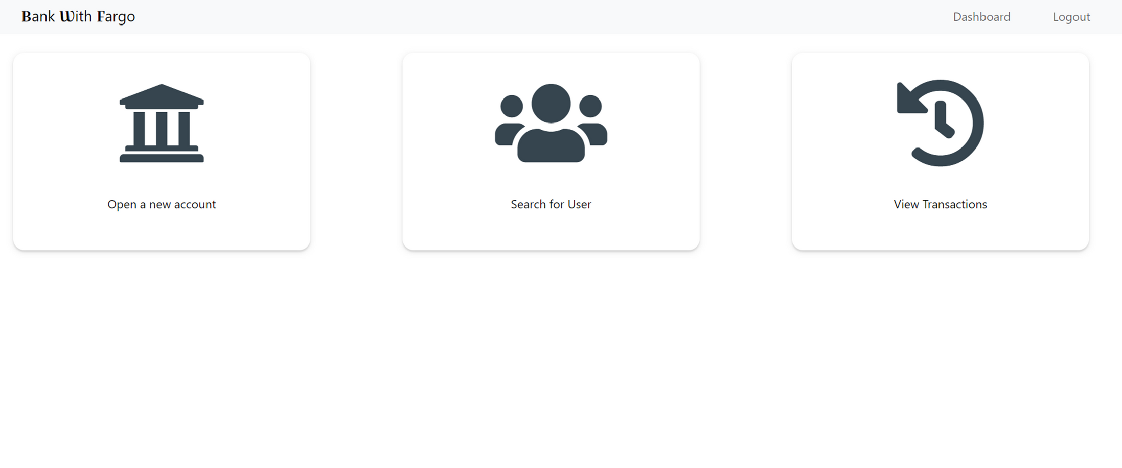
ADMIN DASHBOARD

Slide 12
SCOPE OF IMPROVEMENT
An actual payment system can be integrated to the application to facilitate funds transfer
“Forgot Password” functionality could be added to help user login if they forget their account password
In order to make it a real world banking system, functionalities like credit cards, loan management, pay electricity bill etc. could be added
For security purpose, some fraud detection algorithm could be used to protect against unauthorized access and fraudulent activities
A feature to schedule transactions, bill payments etc. could be incorporated into the application
A mobile application could be made with a user-friendly interface which could support some extra features. For example, it could allow users to deposit checks by taking photo with their phones.

Slide 13

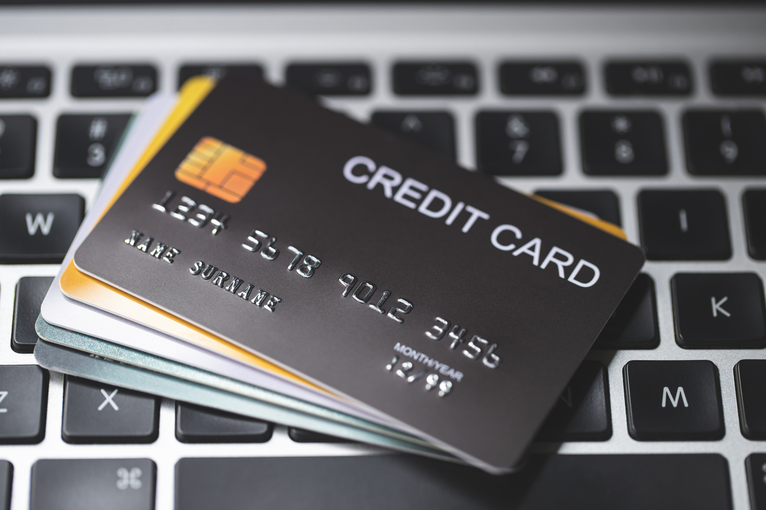
LET'S MOVE TO LIVE DEMO

Slide 14




CHALLENGES FACED
THE PLATFORM WE WERE WORKING ON WAS A LITTLE SLOW AND WASN’T WORKING FOR 2-3 DAYS SO THERE WAS A SLIGHT DELAY BUT WE AS A TEAM MANAGED WELL.
JWT AUTHORIZATION WAS A BIT DIFFICULT AS IT WAS GIVING A LOT OF ERRORS.
LACK OF RESOURCES.

Slide 15

Thank you

